Slide 1

Team LISBON presents:
Mission Impossible
a Java-based game

Slide 2

The TEAM:
Stefan Gramadnikov - the BRAIN, the CODEWRITTER
Pavel Shalev – the HOST, the POSITIVE ATTITUDE, QA
Tihomira Kalchunkova – the COOKIES LADY, the SUPPORT, QA
Emilia Pavlova – the CRAZY-IDEAS ENTHUSIAST, the CODEDELETER, the DESIGNER

Slide 3



The Game:
Main Character
Score
Enemy

Slide 4
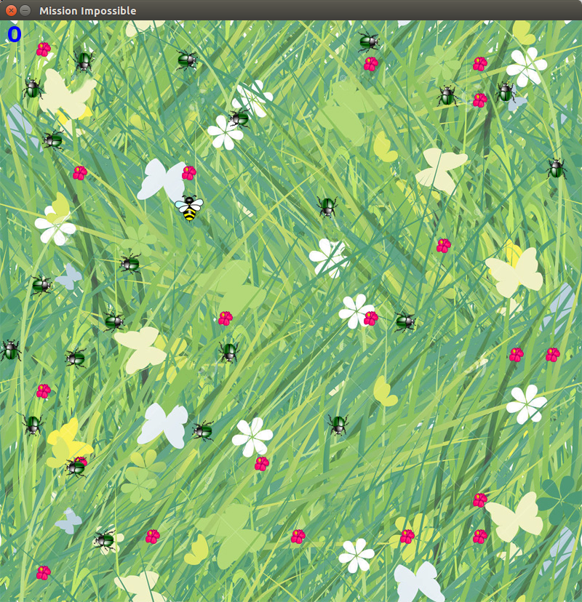
How to accomplish an impossible mission?
Live Demo

Slide 5

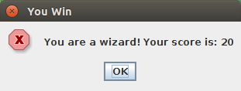
When you accomplish the impossible mission:

Slide 6
Find the GAME here:
https://github.com/EmiliaPavlova/Java-Teamwork
THANK YOU!

